Slide 1

Madupu srilekha
DOCTOR VISIT ANALYSIS USING PYTHON

Slide 2
TEAM MEMBER
NAME:
MADUPU SRILEKHA
COLLEGE:
B V Raju institute of technology
E-MAIL:
srilekhamadupu2002@gmail.com
BRANCH:
ECE
YEAR:
IV-I B.TECH

Slide 3

PROJECT TITLE/Problem Statement
Unveiling Insights into Healthcare: Analyzing Doctor Visit Data

Slide 4

AGENDA
The agenda of analyzing doctor visit data is to gain valuable insights and patterns related to patients' health and healthcare utilization. By exploring the dataset, we aim to understand factors like age, gender, income, and illness severity, and their impact on the frequency of doctor visits. Additionally, we seek to identify correlations between health conditions and reduced activity days. This analysis helps healthcare professionals and policymakers make informed decisions, optimize healthcare services, and provide targeted interventions to improve patient outcomes. Through data-driven approaches, we can enhance patient care, resource allocation, and preventive measures, ultimately promoting better healthcare management and overall well-being in the population.

Slide 5
PROJECT OVERVIEW
The project aims to analyze doctor visit data to gain insights into patients' health and healthcare utilization patterns. By exploring factors such as age, gender, income, and illness severity, we aim to understand their impact on the frequency of doctor visits. The analysis will identify correlations between health conditions and reduced activity days. The project seeks to make data-driven decisions to enhance patient care, optimize healthcare services, and provide targeted interventions for improved healthcare management and overall well-being in the population.
Data Collection & Preprocessing
Exploratory Data Analysis
Data Visualization
Result

Slide 6

WHO ARE THE END USERS of this project?
Healthcare Providers: Doctors, nurses, and other healthcare professionals who can use the insights to better understand patient demographics, health conditions, and healthcare utilization patterns. This knowledge can help in providing personalized care and treatment plans.
Healthcare Administrators: Hospital administrators and healthcare institutions can utilize the findings to optimize resource allocation, plan for staffing needs, and identify areas for improvement in healthcare services.
Public Health Officials: Government health departments and policymakers can use the data to identify health trends, allocate public health resources efficiently, and design targeted interventions for specific health conditions.
Insurance Companies: Insurance providers can benefit from understanding healthcare utilization patterns and associated costs to design suitable insurance plans and assess risk.
Researchers and Academics: Researchers in the field of healthcare and academics can use the data to conduct further studies and contribute to the existing body of knowledge.
General Public: The insights from the analysis can be communicated to the general public through health campaigns, awareness programs, and educational materials to promote preventive measures and better health practices.

Slide 7
YOUR SOLUTION AND ITS VALUE PROPOSITION
My solution provides valuable insights, recommendations, and guidance throughout the dataset analysis, leveraging my knowledge and expertise. The solution involves in-depth analysis of doctor visit data to provide valuable insights into patients' health and healthcare utilization patterns. By exploring factors such as age, gender, income, and illness severity, our analysis helps healthcare providers optimize personalized care, administrators allocate resources efficiently, and policymakers design targeted interventions. Insurance companies can benefit from understanding healthcare utilization and cost patterns. Researchers can utilize the data for further studies, and the general public can be informed through health campaigns. Our solution's value proposition lies in data-driven decision-making for improved healthcare management and overall well-being in the population.

Slide 8
How did you customize the project and make it your own
Understanding the context of the dataset was crucial. To ensure data quality and accuracy, data cleaning and preprocessing were performed. This involved handling missing values, addressing outliers, and transforming the data into a suitable format for analysis. visualization techniques was tailored to the attributes and objectives of the analysis.
Different types of charts, such as bar charts, histograms, scatter plots, and pie charts, were selected to effectively represent the data and reveal patterns and relationships of the data.
Customization using my perspective

Slide 9
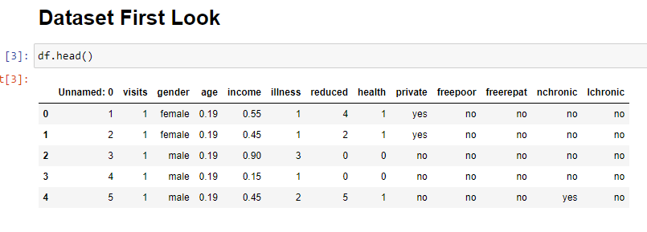
MODELLING
DATA FRAME

Slide 10
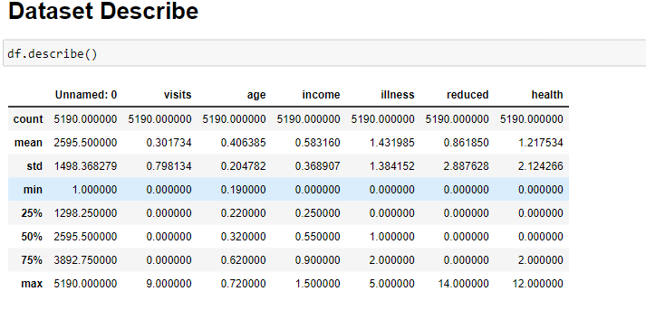
MODELLING
SUMMRY STATISTICS

Slide 11
DATA VISUALISATION
4000
3000
2000
1000
0

Slide 12
UNIVARIATE ANALYSIS
4000
3000
2000
1000
0

Slide 13
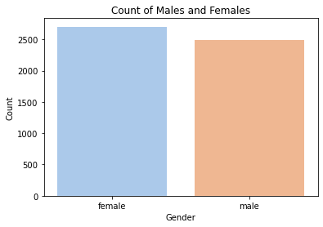
GENDER
The dataset shows that female patients have a slightly higher number of doctor visits compared to male patients .

Slide 14
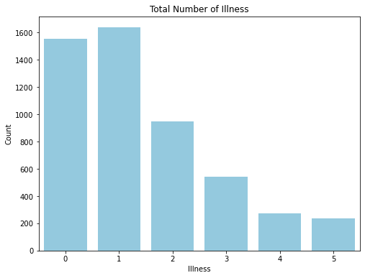
ILLNESS
The majority of patients who have visited the doctor are affected by type 1 disease with 31.6% , followed by the type 0 with 29.9% of patients.

Slide 15
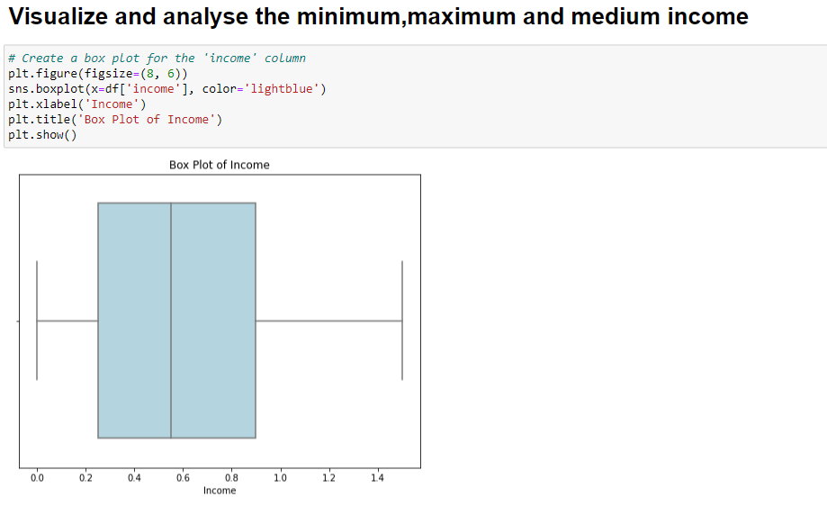
INCOME
Patients with average income levels tend to have more frequent doctor visits, suggesting a correlation between income and healthcare utilization.

Slide 16
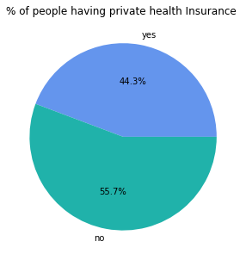
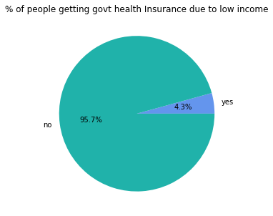
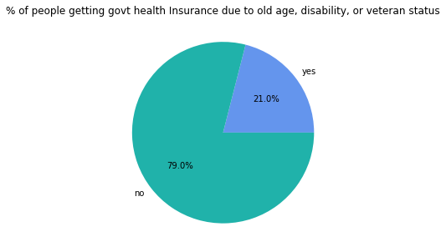
HEALTH INSURANCE COVERAGE

Slide 17
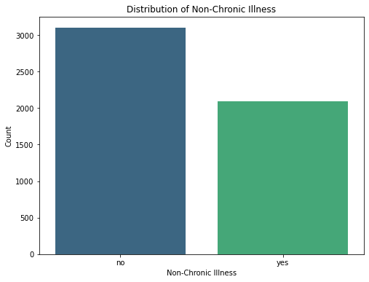
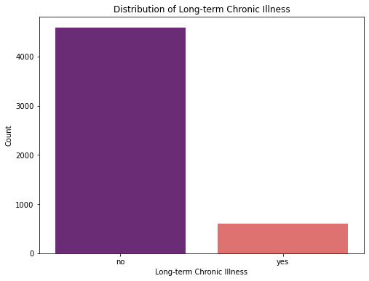
CHRONIC & NON-CHRONIC
Patients with long-term chronic conditions tend to have more doctor visits compared to patients with non-chronic conditions.

Slide 18
BI VARIATE ANALYSIS
4000
3000
2000
1000
0

Slide 19
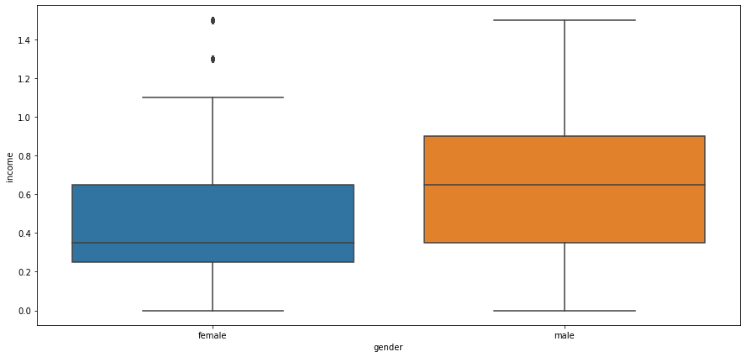
The correlation of income and gendeR
Income and gender are correlated to each other.

Slide 20
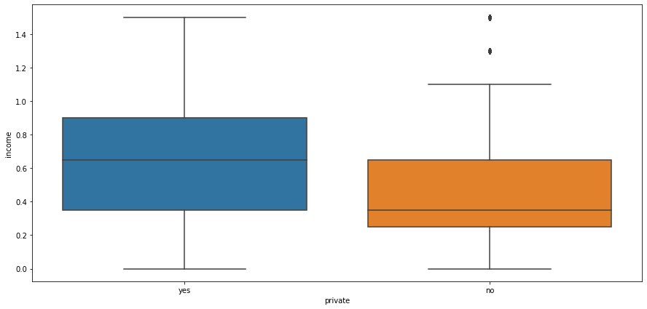
The corrlation of income and privatE
The private and incomeare correlated.

Slide 21
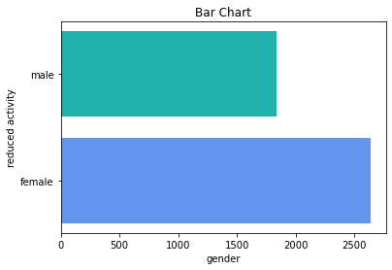
analyze the reduced days of activity due to illneess based on Gender
For male and female there is a reduced illness .

Slide 22
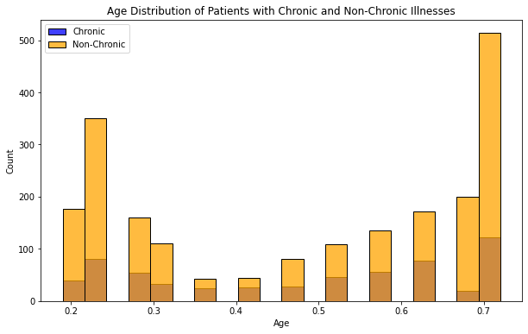
Plot histograms for age distribution of chronic & non-chronic patients
The chronic and non-chronic diseases are distributed based on age.

Slide 23
MULTIVARIATE ANALYSIS
4000
3000
2000
1000
0

Slide 24
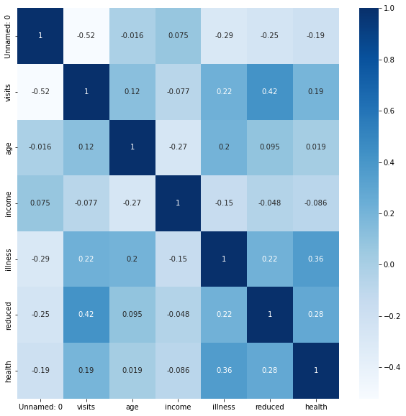
correlation between different variables
The reduced and the visits are highly corelated.
The illness and the health are highly corelated.

Slide 25
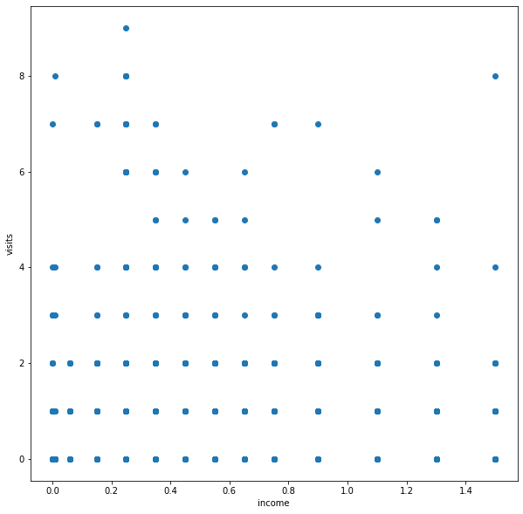
AnAlyZe how the income of a patient affects the no of visits to the hospital
Patients with average income levels tend to have more frequent doctor visits, suggesting a correlation between income and healthcare utilization.

Slide 26
Results
Gender Distribution:
The dataset contains more female records (2702) than male records (2488).
Illness Distribution:
The most common illness level is 1, followed by 0 and 2.
There are also records with illness levels 3, 4, and 5, but they are less frequent.
Reduced Days of Activity:
The dataset contains information about the number of reduced days of activity due to illness, ranging from 0 to 14.
The majority of patients have 0 reduced days of activity, followed by 1 and 2 days.

Slide 27
links
DEMO VIDEO-
https://drive.google.com/file/d/1tVwMW--H7WG5llCsARQe_mfq8G4UYERT/view?usp=sharing
Github link-
https://github.com/Srilekha-09/doctor_visit_analysis_using_python

Slide 28


